Slide 1
Day 3 – Azure Machine Learning Integration
BRK11 – Working with data sources and datasets (25 min)
ACT04 – MENTI: Best practices for securing data and protecting privacy
BRK12 – Azure Machine Learning integration with Azure Synapse Analytics (30 min)
LAB05 – Using Azure Machine Learning from Azure Synapse Analytics Studio
BRK13 – Azure Machine Learning integration with Azure Databricks (30 min)
ACT05 – DISCUSS: MLOps best practices
LAB06 – MLOps with Azure Machine Learning, Azure Pipelines, and GitHub
ACT06 – NENTI: Addressing the challenges of modern data science projects with Azure

Slide 2
BRK11 – Working with data sources and datasets
<Presenter name>
<Presenter title>

Slide 3
Agenda

Slide 4
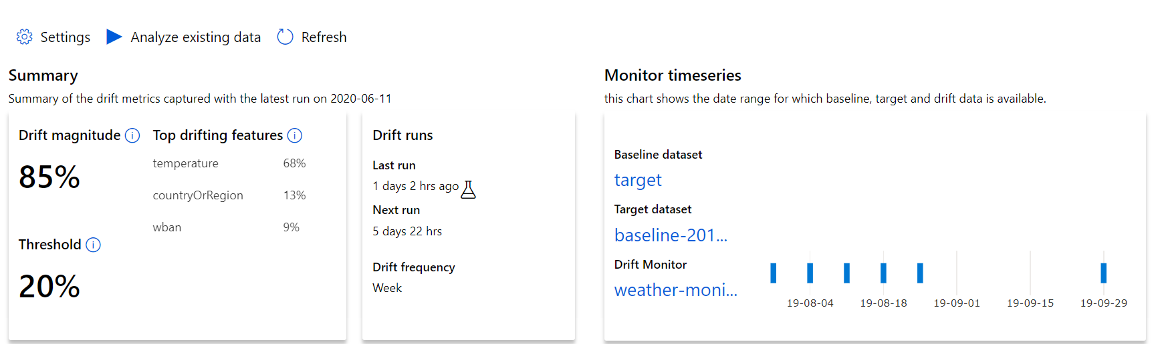
Detecting Data Drift with AML dataset monitors
Review results in AML Studio
Percent drift between baseline & target
Features which drifted the most
Drift beyond this will trigger alerts
Observe drift over time

Slide 5
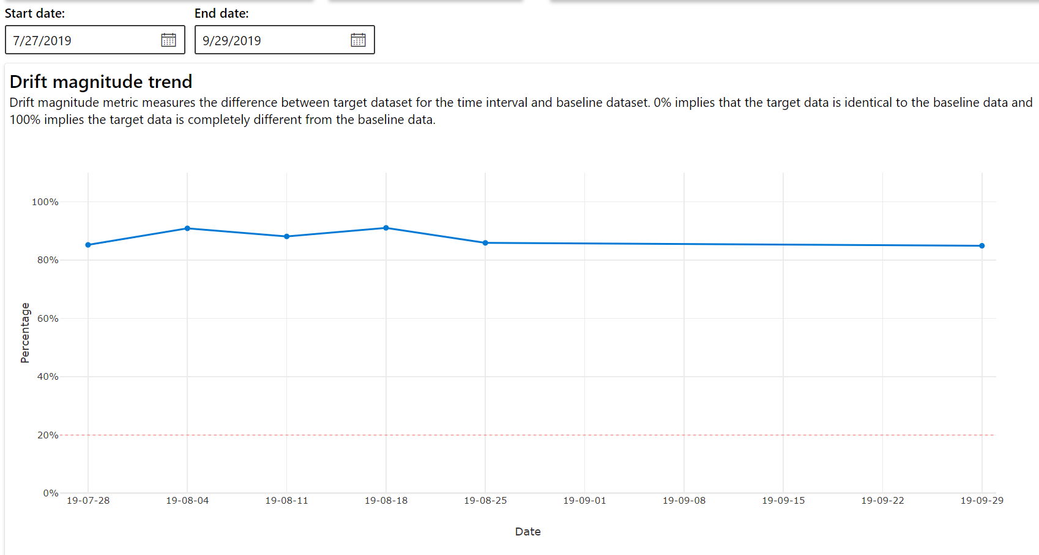
Detecting Data Drift with AML dataset monitors
Review results in AML Studio

Slide 6
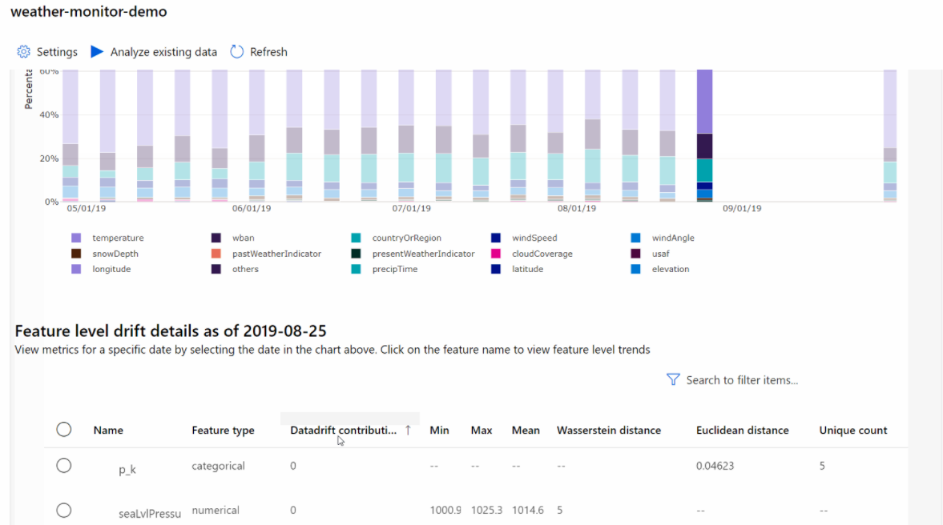
Detecting Data Drift with AML dataset monitors
Review results by feature
Numeric features | Categorical features
Wasserstein distance | Euclidian distance
Mean value | Cardinality (unique values)
Min value
Max value

Slide 7
Understanding Data Drift
Data drift happens over time.
Data drift affects models—they become less accurate as underlying circumstances change.
One solution: constant retraining. Downside: we’re constantly retraining!
Another solution: detect drift and retrain when needed.

Slide 8
Causes of Data Drift
Upstream process changes (e.g., placing sensors in new locations)
Data quality issues (e.g., broken sensor)
Natural drift in data (e.g., seasonality, change in tastes)
Change in relationship between features (i.e., covariate shift)

Slide 9
Detecting Data Drift with AML dataset monitors
Azure Machine Learning dataset monitors help track drift.
Create using AML Studio or the AML SDK
Supports both SQL and flat file data stores
Defines a baseline dataset that represents the original training data
Defines a target dataset that represents the scoring data
Requires timeseries dataset with timestamp column

Slide 10
Detecting Data Drift with AML dataset monitors
Define a variable named “state”
Step 1: Create a target dataset. Must have the timeseries trait:
Timestamp column in the data
Virtual column derived from the path pattern of files
dstore = Datastore.get(ws, 'your datastore name')
dstore_paths = [(dstore, 'weather/*/*/*/*/data.parquet')]
partition_format = 'weather/{state}/{date:yyyy/MM/dd}/data.parquet'
dset = Dataset.Tabular.from_parquet_files(path=dstore_paths, partition_format=partition_format)
dset = dset.with_timestamp_columns('date')
dset = dset.register(ws, 'target')
Define a variable named “date” based on folder names
Load data using the defined partition format
Specify that “date” is a timestamp column

Slide 11
Detecting Data Drift with AML dataset monitors
Set a baseline of expected activity
Step 2: Create a dataset monitor
dset = Dataset.get_by_name(ws, 'target')
baseline = target.time_before(datetime(2019, 2, 1))
features = ['latitude', 'longitude’, ... ]
monitor = DataDriftDetector.create_from_datasets(ws,
'drift-monitor’, baseline, target,
compute_target='cpu-cluster’,
frequency='Week’,
feature_list=None,
drift_threshold=.6,
latency=24)
Create a data drift detector object
Define frequency of scheduled tasks
How much drift is acceptable

Slide 12
Detecting Data Drift with AML dataset monitors
Backfill from January to May, 2019
Step 3: Run a backfill
monitor = DataDriftDetector.get_by_name(ws, 'drift-monitor')
monitor = monitor.update(feature_list=features)
backfill1 = monitor.backfill(datetime(2019, 1, 1), datetime(2019, 5, 1))
backfill1 = monitor.backfill(datetime(2019, 5, 1), datetime.today())
monitor = monitor.disable_schedule()
monitor = monitor.enable_schedule()
Backfill from May, 2019 to now
Stop performing drift detection
Start performing drift detection

Slide 13
Detecting Data Drift with AML dataset monitors
Review results in AML Studio
Percent drift between baseline & target
Features which drifted the most
Drift beyond this will trigger alerts
Observe drift over time

Slide 14
Detecting Data Drift with AML dataset monitors
Review results in AML Studio

Slide 15
Detecting Data Drift with AML dataset monitors
Review results by feature
Numeric features | Categorical features
Wasserstein distance | Euclidian distance
Mean value | Cardinality (unique values)
Min value
Max value

Slide 16
BRK12 – Azure Machine Learning integration with Azure Synapse Analytics
<Presenter name>
<Presenter title>

Slide 17
Agenda

Slide 18

Azure Synapse Analytics
Limitless analytics service with unmatched time to insight
Artificial Intelligence / Machine Learning / Internet of Things
Intelligent Apps / Business Intelligence
Designed for analytics workloads at any scale
Synapse Analytics
SaaS developer experiences for code free and code first
Experience
Synapse Analytics Studio
Platform
Multiple languages suited to different analytics workloads
MANAGEMENT
Languages
MANAGEMENT
SQL
Python
.NET
Java
Scala
Integrated analytics runtimes available dedicated and serverless
Synapse SQL offering T-SQL for batch, streaming and interactive processing
Apache Spark for big data processing with Python, Scala and .NET
SECURITY
Form Factors
SECURITY
DEDICATED
SERVERLESS
MONITORING
Analytics Runtimes
MONITORING
SQL
METASTORE
METASTORE
DATA INTEGRATION
Integrated platform services for, management, security, monitoring, and meta-store
Azure
Data Lake Storage
Common Data Model
Enterprise Security
Optimized for Analytics
Data lake integrated and Common Data Model aware
Notes:
Hand it over to Lino

Slide 19









Modern Data Warehouse
INGEST
PREPARE
TRANSFORM & ENRICH
SERVE
VISUALIZE
AZURE SYNAPSE ANALYTICS
Synapse SQL (Dedicated)
Synapse Pipeline
Synapse SQL (Dedicated)
Data Sources
Synapse SQL (Serverless)
Synapse Pipeline
Power BI
OR
OR
Synapse Pipelines
Synapse SQL (Serverless)
Apache Spark
Apache Spark
Synapse SQL (Serverless)
STORE
ADLS Gen 2
Storage Account
Data Lake

Slide 20


Synapse Pipelines
Trigger
Pipeline
foreach (…)
On demand
Schedule
Data Window
Event
Activity
Activity
Activity
Activity
Activity
Self-hosted
Integration Runtime
Azure
Integration Runtime
Linked
Service
LEGEND
On-prem
Apps & Data
Azure Services
Command and Control
Data
Synapse Pipelines shares codebase with Azure Data Factory

Slide 21
Understanding Synapse Pipelines and ML Pipelines
 | Synapse Pipeline | ML Pipeline
Used for: | Data movement and transformation | Model training
Used by: | Data engineers | Data scientists

Slide 22
BRK13 – Azure Machine Learning integration with Azure Databricks
<Presenter name>
<Presenter title>

Slide 23
Agenda
Introduce Spark
Introduce Databricks
How AML plays in the ecosystem

